Slide 1
SRI SAIRAM COLLEGE OF ENGINEERING
DEPARTMENT OF MECHANICAL ENGINEERING
PROJECT TITLE
PERFORMANCE AND EMISSION ANALYSIS OF 4 STROKE DIESEL ENGINE WITH EUCALYPTUS OIL AND DIESEL BLENDING
SUBMITTED
BY
TEAM MEMBERS USN
MEHBOOB HOSSAIN
SUJITH KUMAR P
CHRIS SHASHANK D
1SB20ME007
1SB20ME016
1SB20ME002

Slide 2
ABSTRACT
This paper describes an experimental study of concerning the feasible of using bio-oil namely EUCALYPTUS OIL.
The emission and performance characteristic of diesel engine were studied through dual fuel mode.
EUCALYPTUS OIL as contains high amount of cineole content
EUCALYPTUS was inducted as a primary fuel through induction manifold and diesel was admitted into the engine through conventional fuel device as an ignition.
The result shows that except volumetric efficiency , all other parameters and emissions parameters are better than that of diesel fuel with in 60% load and around 40-45% smoke reduction is obtained with this dual fuel mode
This study has proved that approximately 75% diesel replacement with EUCALYPTUS is possible by dual fuel mode with little engine modification

Slide 3
INTRODUCTION
In this investigation, the characteristic of combustion of natural gas in an un modified diesel engine using pilot injection method.
In this investigation the suitability of eucalyptus oil as an alternative fuel for diesel engine.
They found that the eucalyptus oil provide a significant reduction in viscosity , thereby enhancing the physical properties of the renewable fuel to improve engine performance.
In this paper that the engine performance with eucalyptus oil differed a little from engine performance with diesel fuel.
They concluded that the engine with eucalyptus oil gives lower HC,CO emission and smoke than conventional diesel at optimum condition .
eucalyptus oil be easily substituted up to 20% diesel without any significant difference in power output and break thermal efficiency.

Slide 4
EUCALYPTUS OIL
Eucalyptus oils in the trade are categorized into three broad types according to their composition and main end-use: medicinal, perfumery and industrial
China produces about 75% of the world trade, but most of this is derived from the cineole fractions of camphor laurel rather than being true eucalyptus oil.
The cineole-based oil is used as component in pharmaceutical preparations to relieve the symptoms of influenza and colds, in products like cough sweets, lozenges, ointments and inhalants.
Research shows that cineole-based eucalyptus oil (5% of mixture) prevents the separation problem with ethanol and petrol fuel blends.
Eucalyptus oil also has a respectable octane rating and can be used as a fuel in its own right. However, production costs are currently too high for the oil to be economically viable as a fuel.

Slide 5
PROPERTY
Diesel EB100 EB75 EB50 EB25
Average molecular weight 310 275 245 213 170
Carbon content (wt.%) 77.0 — — — 86
Hydrogen content (wt.%) 12.18 — — — 14
Oxygen content (wt.% 10.32 — — — 0
Nitrogen content (wt.%) 0 — — — 0
Gross heating value (MJ/kg) 40 40.76 42.53 43.8 45.7
Specific gravity at 15°C 896 891 884 876 852
Viscosity at 40°C (cSt) 2.99 2.62 2.36 1.91 1.57
Flash point (°C) 105 84 76 71 67
Cetane number 53 52.2 51.5 50.75 49

Slide 6
WORKING PRINCIPLE
A heat engine Is a machine, which converts heat energy into mechanical energy . The combustion of fuel such as coal , petrol , diesel generates heat . This heat is supplied to the working substance at high temperature. By the expansion of this substance in suitable machine , heat energy is converted into useful work.
Heat engine can be further divided into two types:
External combustion and Internal combustion.
In a steam engine the combustion of fuel takes place outside the engine and thus the steam is formed is used to run the engine . Thus , it is known as external combustion engine.
In case of internal combustion engine ,the combustion of fuel takes place inside the engine cylinder itself.
The IC engine can be further classified as:
stationary or mobile, horizontal or vertical and low, medium or high speed.

Slide 7
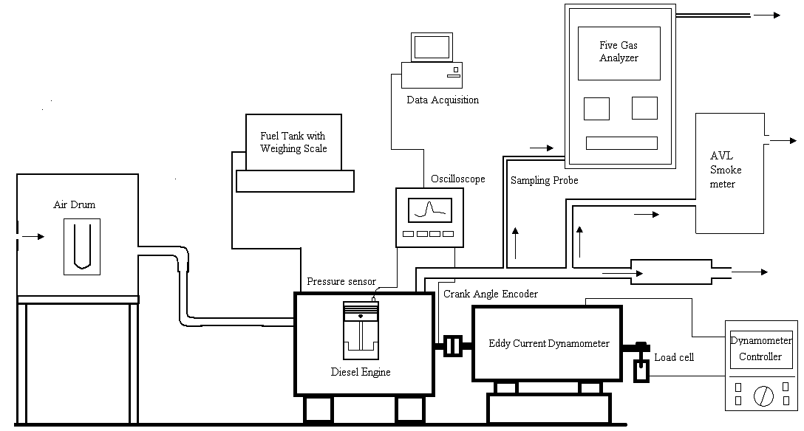

Slide 8
TABULATION 1
This Readings are taken with 100% Diesel using Engine Test Express V5-80 in single cylinder high speed diesel engine.
Where:
Co = Carbon Monoxide in PPM
Co₂ = Carbon di Oxide in PPM
HC = Hydro Carbons in PPM
No_{x} = Nitrous Oxide in PPM
V = Voltage in Volts
I = Current in Ampere
Formula: Load = Voltage * Current= 220*4.09 = 899.8 Watts = 0.9 Kw
OBSERVATION TABLE
Fuel : Diesel Date : 15/3/2020 Injection Pressure: 185bar
S.No | Load “VI” | Time Taken for 5cc of fuel consumption “Sec” |  |  | Exhaust gas Temperature “ºC” | Emission “PPM”
 |  | t₁ | t₂ | T |  | Co | Co₂ | HC | NO_{X}
1. | 0 | 62 | 61 | 61.5 | 160 | 150 | 500 | 260 | 680
2. | 0.9 | 39 | 41 | 40 | 169 | 192 | 1700 | 290 | 1250
3. | 1.8 | 34 | 33 | 33.5 | 185 | 383 | 3200 | 340 | 1370
4. | 2.7 | 28 | 27 | 27.5 | 198 | 457 | 3650 | 430 | 1425
5. | 3.6 | 16 | 14 | 15 | 207 | 525 | 4100 | 490 | 1550

Slide 9
TABULATION 2
This Readings are taken with blending of 80% Diesel and 20% Eucalyptus oils using Engine Test Express V5-80 in single cylinder high speed diesel engine.
FORMULA LOAD= VOLTAGE *CURRENT
OBSERVATION TABLE
Fuel : Diesel with Eucalyptus oils Date : 15/3/2020 Injection Pressure: 185bar 20% Blending of Eucalyptus oils.
S.No | Load “VI” | Time Taken for 5cc of fuel consumption “Sec” |  |  | Exhaust gas Temperature “ºC” | Emission “PPM”
 |  | t₁ | t₂ | T |  | Co | Co₂ | HC | NO_{X}
1. | 0 | 60 | 59.5 | 60 | 231 | 120 | 200 | 200 | 650
2. | 0.9 | 43 | 42 | 43 | 308 | 130 | 1500 | 210 | 1250
3. | 1.8 | 33.5 | 33 | 33.5 | 408 | 250 | 3000 | 260 | 1335
4. | 2.7 | 26 | 27 | 26 | 538 | 383 | 3250 | 310 | 1390
5. | 3.6 | 21 | 20.5 | 21 | 704 | 453 | 4250 | 360 | 1425

Slide 10
TABULATION 3
This Readings are taken with blending of 70% Diesel and 30% Eucalyptus oils using Engine Test Express V5-80 in single cylinder high speed diesel engine.
Formula: Load = Voltage * Current
OBSERVATION TABLE
Fuel : Diesel with Eucalyptus oil Date : 15/3/2020 Injection Pressure: 185bar 30% Blending of Eucalyptus oil.
S.No | Load “VI” | Time Taken for 5cc of fuel consumption “Sec” |  |  | Exhaust gas Temperature “ºC” | Emission “PPM”
 |  | t₁ | t₂ | T |  | Co | Co₂ | HC | NO_{X}
1. | 0 | 53 | 54 | 53 | 270 | 110 | 180 | 170 | 600
2. | 0.9 | 39 | 40 | 39 | 305 | 115 | 1400 | 210 | 1175
3. | 1.8 | 30 | 31 | 30 | 396 | 180 | 2800 | 230 | 1225
4. | 2.7 | 24 | 23 | 24 | 540 | 220 | 2900 | 255 | 1275
5. | 3.6 | 18.5 | 16 | 18 | 715 | 300 | 3200 | 290 | 1325

Slide 11
ENGINE PERFORMANCE
B.P. Vs SFC

Slide 12
ENGINE PERFORMANCE
B.P. Vs T.E.

Slide 13
ENGINE PERFORMANCE
B.P. Vs Exhaust Temperature

Slide 14
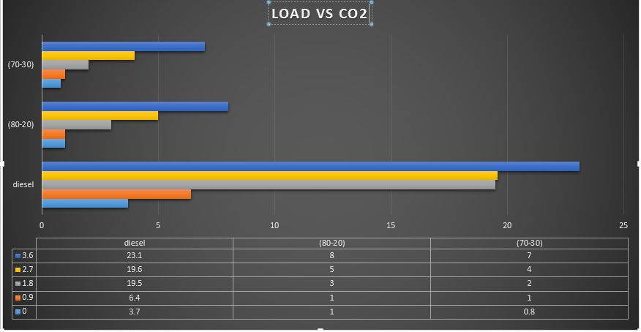
EFFECT ON EMISSIONS

Slide 15
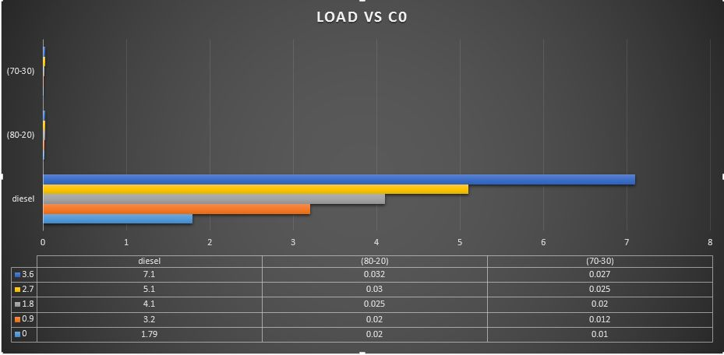
EFFECT ON EMISSIONS

Slide 16
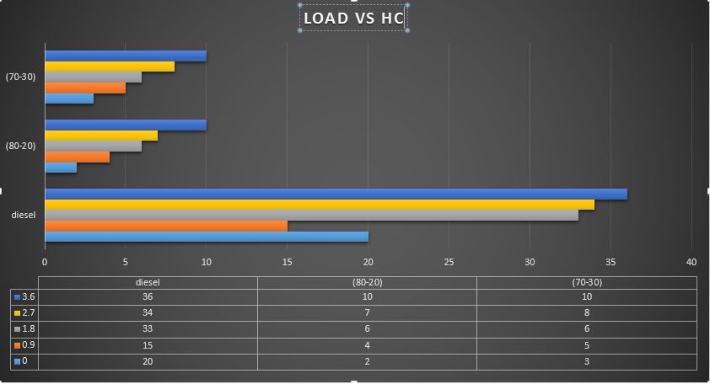
EFFECT ON EMISSIONS

Slide 17
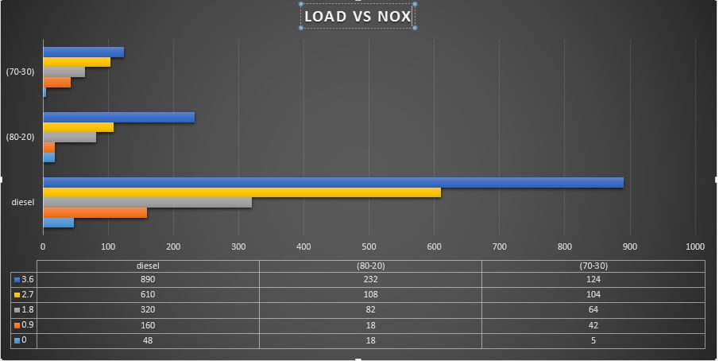
EFFECT ON EMISSIONS

Slide 18
RESULT
The aim of this study is to investigate the suitability of eucalyptus biodiesel as an alternative to diesel fuel. Some properties of eucalyptus oil show that it is not possible to fuel diesel engines with this crude oil due to problems generated by its high viscosity and low volatility.
In order to decrease the oil viscosity, transesterification technique is carried out under optimum reaction condition.
Analysis of basic properties of eucalyptus biodiesel shows that transesterification process is successfully employed to make the viscosity and other characteristics comparable to those of diesel fuel.
On the basis of the exhaustive engine tests, the following conclusions can be drawn: (i)analysis of combustion shows that biodiesel and all its blends exhibit similar pressure-time history as diesel fuel.
No undesirable combustion features such as unacceptable high cylinder pressure rises are observed.

Slide 19
Conclusion
The combustion duration increases with increase in the proportion of biodiesel in the blend due to rise of the fuel quantity injected in the cylinder;
the BSFC increases and BTE decreases with addition of biodiesel content in the blend. A reverse behaviour is observed with increase in engine load;
CO, HC, and particulates in the exhaust emissions decrease, whereas NOx increase with increases in percentage of biodiesel in the blend. However, the level of emissions increases with increase in engine load for all fuels tested.
A general conclusion is that the eucalyptus biodiesel can be used in the form of blends to compromise on the NO emissions and thermal efficiency.

Slide 20
THANK YOU

